Slide 1
Oscillations
Dr. Arpan Maiti
Physics Division
Department of Basic Science and Humanities
University of Engineering and Management

Slide 2
Oscillations
Periodic and Oscillatory motion
Simple Harmonic Motion—
Energy in Simple Harmonic Motion
The Period and Sinusoidal Nature of SHM
The Simple Pendulum
Spring Oscillations

Slide 3
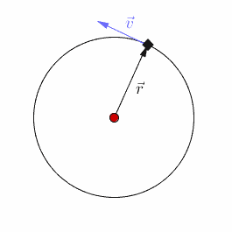
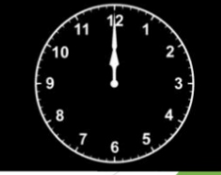
Periodic Motion
The motion in which repeats after a regular interval of time is called periodic motion.
The smallest interval of time after which the motion is repeated is called its Time period (T).
The reciprocal of T gives the number of repetitions that occur per unit time. This quantity is called the frequency.

Slide 4

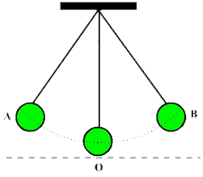

Oscillatory motion
To and fro motion of the body about a definite point (called equilibrium position/mean position) is called oscillatory motion.
This is also a periodic motion.
There exist a restoring force which tries to bring the body back to the equilibrium point, giving rise to oscillations or vibrations.
All oscillatory motions are periodic But all periodic motions not oscillatory

Slide 5



Periodic and Oscillatory motion
Periodic motion
Oscillatory motion
Oscillatory motion

Slide 6
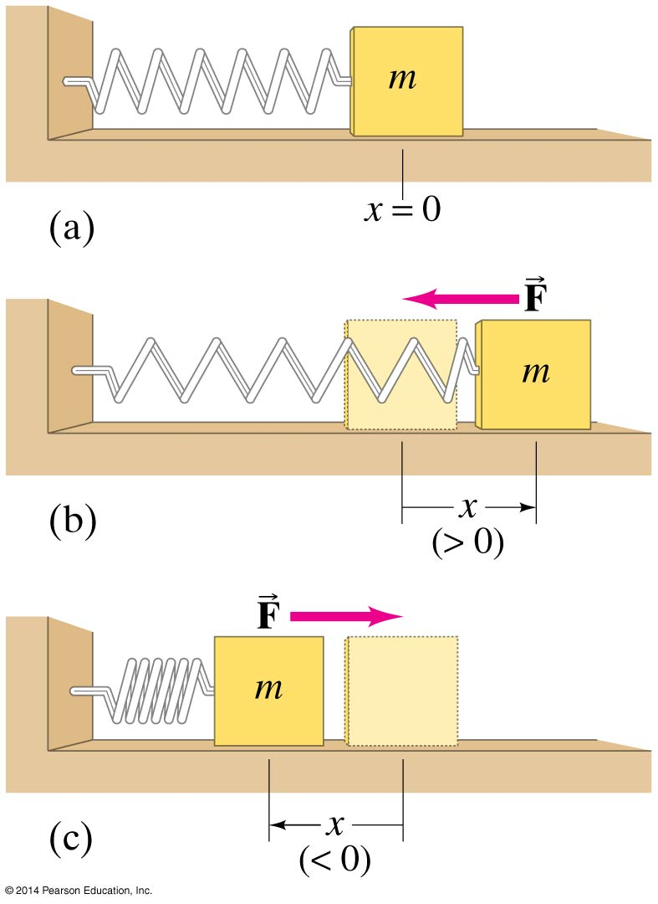
Spring Oscillations
If an object vibrates or oscillates back and forth over the same path, each cycle taking the same amount of time, the motion is called periodic. The mass and spring system is a useful model for a periodic system.

Slide 7

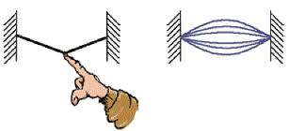
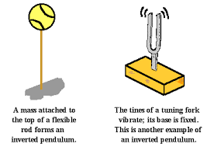
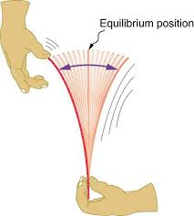

Some examples of oscillatory motion

Slide 8
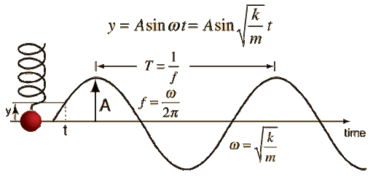
Simple Harmonic Motion
The motion is periodic and oscillatory.
The motion is linear.
The restoring force acting on the body (i.e. the acceleration of the body) is proportional to and oppositely directed to its displacement measured from the equilibrium position.

Slide 9
Equation of SHM

Slide 11
Velocity of the particle executing SHM

Slide 13
Acceleration of the particle executing SHM

Slide 14
Energy of the particle executing SHM
A particle executing SHM possesses both potential and kinetic energy at any instant.
Total Energy = Kinetic Energy + Potential Energy
Expression of Kinetic Energy:

Slide 15
Expression of Potential Energy:
Potential energy of a vibrating particle of mass m at any instant is calculated from the total amount of work done in overcoming the restoring force through a distance x .

Slide 16
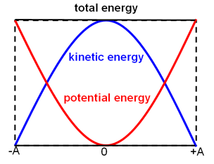
Total Energy of the particle executing SHM

Slide 17
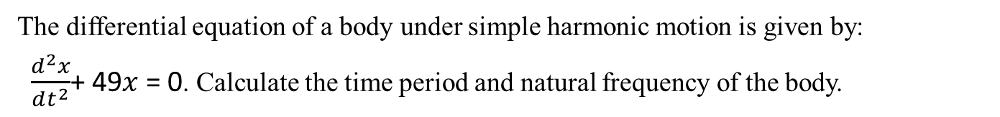
The differential equation of a body under simple harmonic motion is given by:
$\frac{d^{2}x}{dt^{2}}$+ 49$x$ = 0. Calculate the time period and natural frequency of the body.

Slide 18
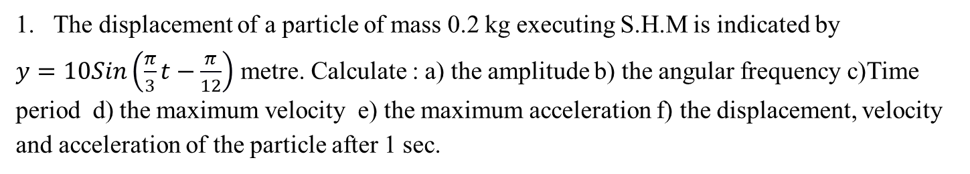
The displacement of a particle of mass 0.2 kg executing S.H.M is indicated by
$y=10Sin\left(\frac{π}{3}t−\frac{π}{12}\right)$ metre. Calculate : a) the amplitude b) the angular frequency c)Time period d) the maximum velocity e) the maximum acceleration f) the displacement, velocity and acceleration of the particle after 1 sec.

Slide 21
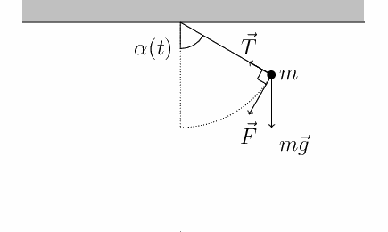
Motion of a simple pendulam

Slide 23

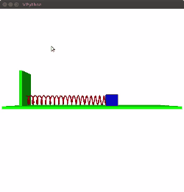
Spring Mass system.
Harmonic Oscillator

Slide 24
Time Period of Spring Mass System.

